Slide 1
FirstDiscovery LLC
Pricing Strategy, Supply Chain, and BI Solution Services

Slide 2


Agenda
1 |  | Introductions
2 |  | Our Pricing Approach
3 |  | Tracking ROI
4 |  | Sample Project Timeline
5 |  | Next Steps

Slide 3


Meeting with You Today
Dan Combs
Pricing Lead
Deb Lee
Business Intelligence Lead
Dan is a Manager of Strategic Pricing in Elsevier’s Clinical Solutions business. He has extensive experience working across the pricing lifecycle from market research and price structuring to execution and operations in both B2B and B2C environments. He specializes in using pricing analytics to drive margin expansion with industrial product goods. Dan received his B.S. in Chemical Engineering from Penn State University.
Deb is a consultant in Thorogood Associates' BI and Analytics practice. She specializes in developing bespoke technology solutions for consumer product companies and has a strong background in end-to-end BI solution design. Her strengths include database warehousing, systems integration, and user acceptance testing. Deb received her Masters in Biomedical Engineering from Penn State University.
Representative experience
Led Total Price Assessment (TPA) for Fortune 250 chemicals manufacturer
Analyzed hundreds of thousands of transactions across 12 business lines to identify largest instances of price erosion
Developed financial model using advanced analytics to grow addressable revenue by 5%
Developed Configure-Price-Quote (CPQ) technology for $40M product suite
Incorporated complex logic around customer-specific pricing and product bundling discounts
Designed simplified back-end processes to expedite Quote-to-Cash (QtC) processing
Representative experience
Led BI solution design for Fortune 250 Health Insurer
Analyzed and designed 60+ dashboards to standardize forecasting, analytics, and reporting in end-to-end Tableau / Hadoop solution for C-suite executives
Designed eCommerce and Mixed Marketing Modeling analytics models for Fortune 250 Global Consumer Packaged Goods manufacturer
Led development team to design SQL Server data ingestion, ETL, and reporting
Designed reporting suite for global eCommerce and Brick & Mortar market share forecasting
Optimized Mixed Marketing Modeling analytics to increase ROI across 100+ brands

Slide 4
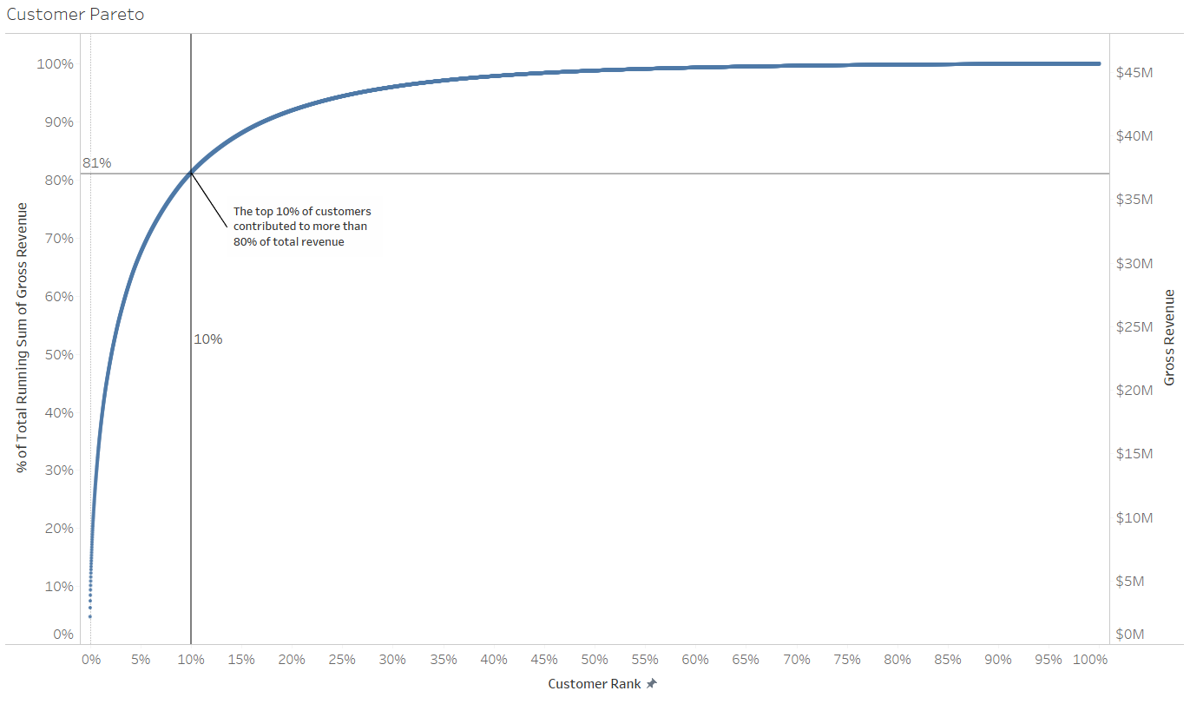
Our Pricing Approach (1 of 3)
We understand that every client is unique and requires recommendations specific to their business; however, in general, we apply the following guidelines to identify opportunities for margin expansion:
1
Customer Pareto: We maintain a customer-centric view from start to finish. We start by creating customer Paretos – an analysis that ranks customers based on their revenue contribution across the entire business. A customer’s rank in the Pareto helps answer the question “do your best customers receive the best pricing?” as we begin to assess variation in product pricing

Slide 5
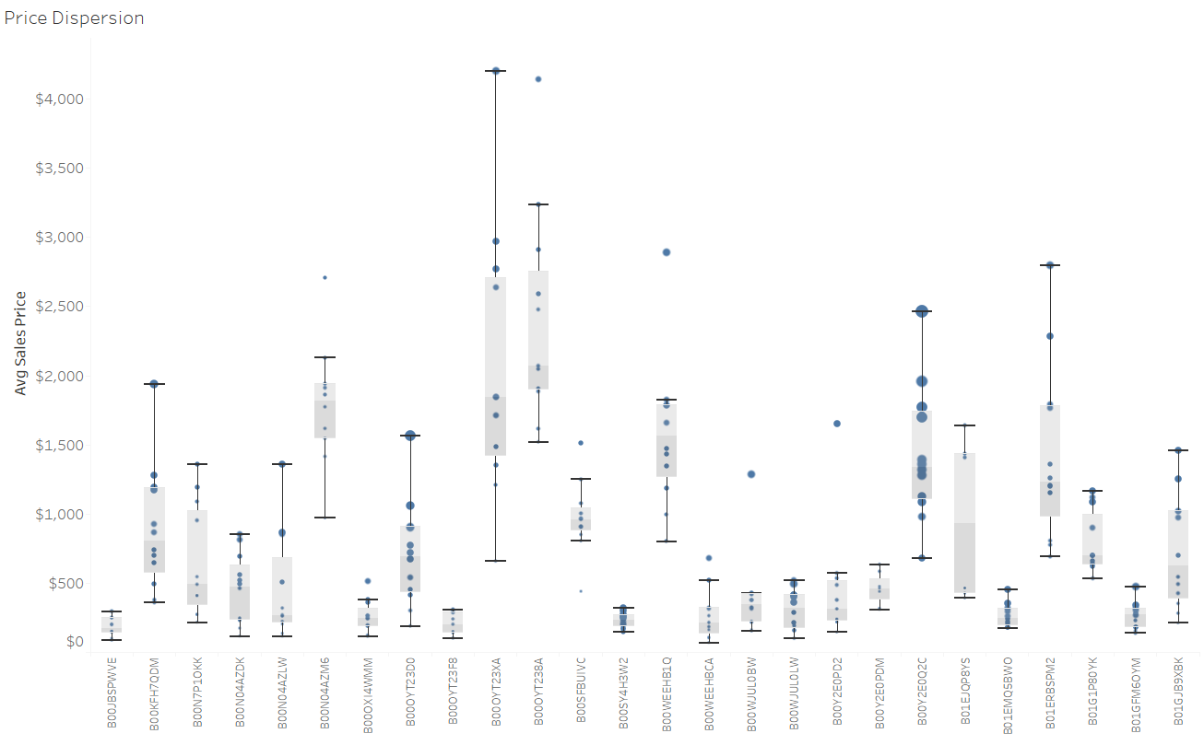
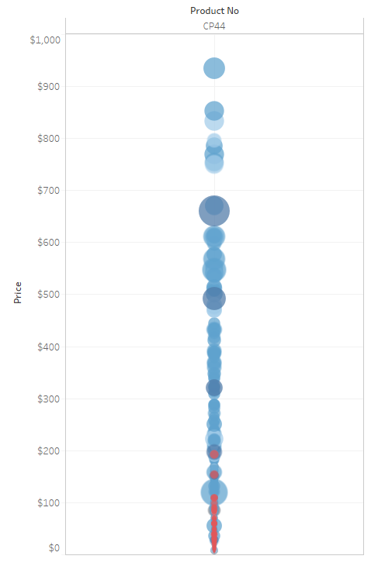
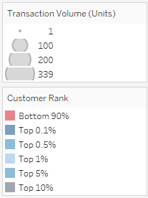
Our Pricing Approach (2 of 3)
2
Price Dispersions: Next, we create price dispersions to understand how much variability in pricing occurs across the product portfolio. The products with the highest numbers of transactions and greatest amount of price variation will yield the largest opportunities
Low-end outliers are often prime candidates for quick results (i.e., “low-hanging fruit”)
Targeted Customer-Product analyses across millions of transactions assess how well price correlates with Transaction Volume and Customer Rank (based on overall revenue contribution)
!
Lowest ranked customers purchasing the lowest volumes received the best pricing for Product CP44

Slide 6
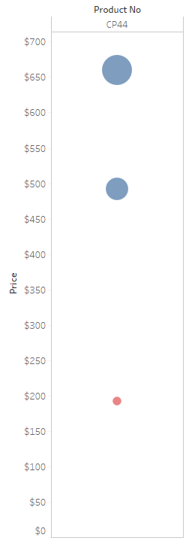
Our Pricing Approach (3 of 3)
3
Uplift Calculations: The final step is to calculate where the largest pricing opportunities exist. A series of recommended price points are provided for under-priced transactions, accompanied by the resulting revenue uplift
Customer Rank: Top 0.1%
Transaction Volume: 339 units
Price: $660
Revenue: $223,740
Customer Rank: Top 0.1%
Transaction Volume: 189 units
Price: $492
Revenue: $92,988
Target Price: $212
Transaction Volume: 28 Units
Target Revenue: $5,936
Revenue Uplift: $560
Customer Rank: Bottom 10%
Transaction Volume: 28 units
Price: $192
Revenue: $5,376
Price change recommendations utilize a number of analytical techniques, including Weighted Averages, Best Customer Analysis, and Gross Margin Percentiles to formulate a recommended price point. Further, price recommendations ensure price deltas are reasonably limited (e.g., no price increases greater than 10%)

Slide 7
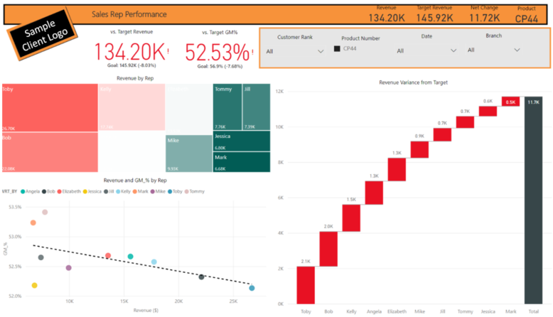
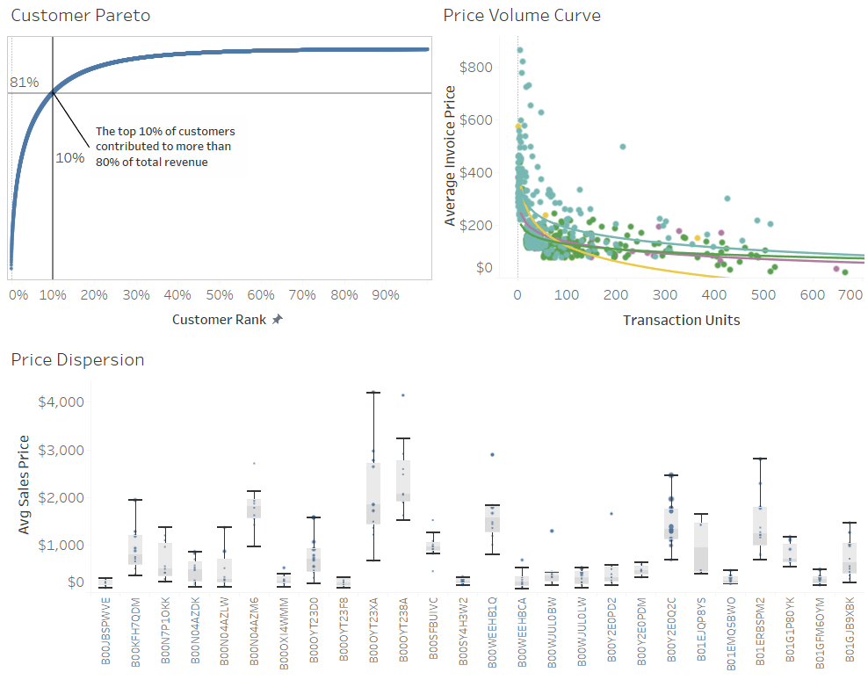
Measuring ROI
We recommend a data-visualization software, customized by our team to provide a suite of powerful pricing dashboards, to enable ROI monitoring and inform business decisions
Power BI
Tableau
Others?
Already working with a BI software?
Prefer another tool not on this list?
Our team of skilled BI specialists can work with any software of your choosing!
User-Friendly: Power BI Gateway provides easy integration of data from multiple sources (databases, CSVs, etc.). Graphical user interface provides intuitive platform for users to create analyses. All functionality integrates seamlessly with Mobile App
Cost Efficient: Power BI Desktop is downloadable for free, while PowerBI.com Service Pro licenses can be purchased for $10/month/user, making Power BI one of the cheapest BI tools on the market
Scalable: licenses can be added or removed at any time. Server licenses offer any user across the organization the ability to access the same analyses, providing a golden source of truth
Connectivity: live connections to transactional databases enable Power BI to refresh analyses at any time without having to recreate work
BI Market Leader: Tableau has consistently been a pioneer in the Gartner magic quadrant for business intelligence technologies year after year. Each subsequent release introduces new features that have led the market in terms of functionality and semantic layer data vision
Flexible: Tableau’s wide selection of visuals and user-authoring functionality make it a clear choice for organizations looking to bring together disparate data sources. Tableau Helper offers an ETL tool to ease the ingestion process
Free versions available: Tableau Reader is available for users that only need to view reports. Users don’t need to have Tableau desktop in order to view reports on Tableau server
Connectivity: Tableau has no limit for extract data sizes and can be programmed to schedule data refreshes directly from servers

Slide 8
Overview of Sample Project Timeline
Pricing analysis occurs in parallel with the development of a BI solution that can be used for tracking price realization (ROI) and adjusting product pricing as needed
 |  | Week 1 |  |  |  |  | Week 2 |  |  |  |  | Week 3 |  |  |  |  | Week 4 |  |  |  |  | Week 5 |  |  |  |  | Week 6 |  |  |  |  | Week 7 |  |  |  |  | Week 8 |  |  |  |  | Week 9 |  |  |  |  | Week 10 |  |  |  |  | Week 11 |  |  |  |  | Week 12 |  |  |  |  | Week 13+
Pre-Project Requirements | Finalize Legal Agreements (NDAs, Contract, Price)
 | Align on Project Scope / Timeline
Pricing Program | Data cleansing / enriching
 | Discovery (Initial Insights)
 | Price Recommendations Formalized
 | Program implementation
Price Realization | BI Solution Design
 | Requirements gathering
 | Analysis & Design
 | Development
 | Testing (Systems Integration, Performance, User Acceptance)
 | Tracking
 | Knowledge Transfer / Handoff
 | Post Go-Live Support
Pricing Program Go-Live
BI Solution Go-Live

Slide 9
Next Steps
Determine appetite for a pricing program refresh
Discuss specific business needs and technology requirements
Align on project timeline and final deliverables
For Discussion
Client-side resource support
Data access and legal protection (NDAs, contracts)
Project cadence
Fees / payment structure
1
2
3

